Slide 1
Text Style Transfer
Final Project
Notes:
Nidhi

Slide 2
Overview
We worked on Text Style Transfer adopting 2 approaches and we will talk about why we segued from a Supervised approach to an Unsupervised approach:
Supervised Encoder-Decoder Sequence-to-Sequence model With Self-Attention
Unsupervised Encoder-Decoder transformer model with iterative refinement and translation model.
Notes:
Nidhi

Slide 3
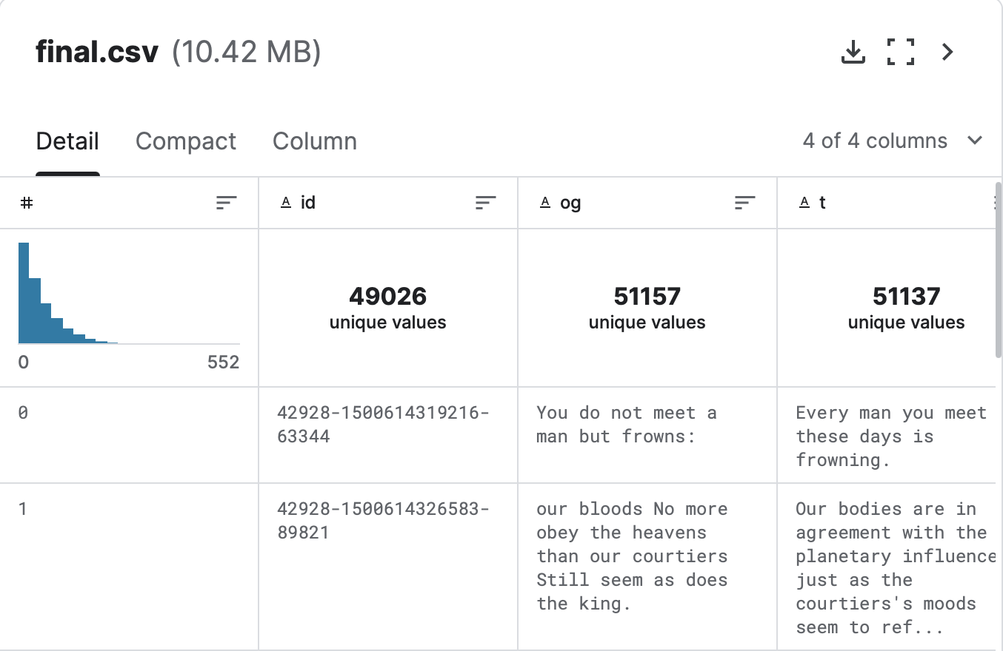
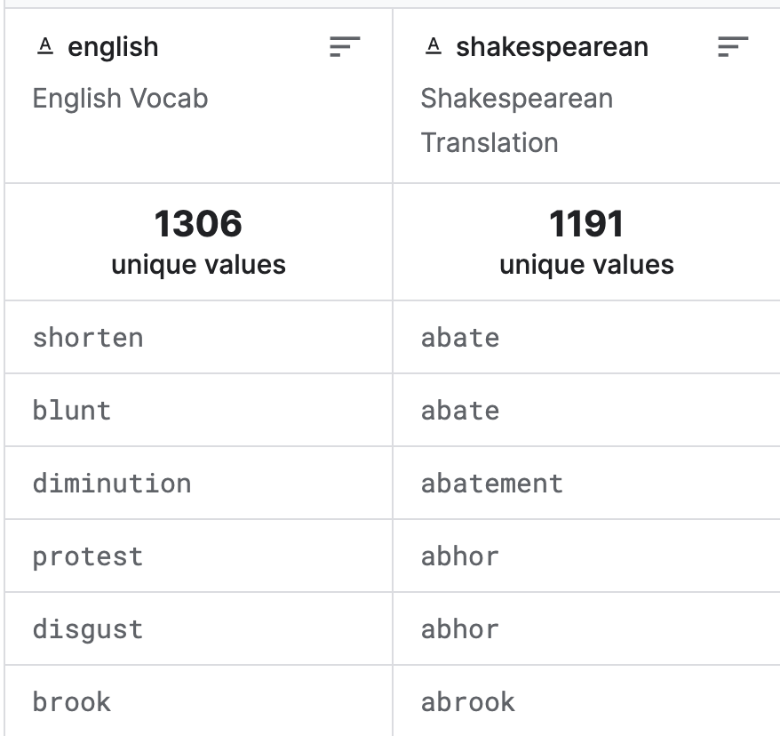
Dataset
The dataset is scraped from Shakescleare which has translations for all of Shakespeare's plays.Thanks to Garnav Aurha for compiling this parallel dataset. It includes each line of the play and its modern English translation.
og is the original Shakespeare text t is the modern English translation id is arbitrary id for each row in the dataset.
Notes:
Nidhi

Slide 4
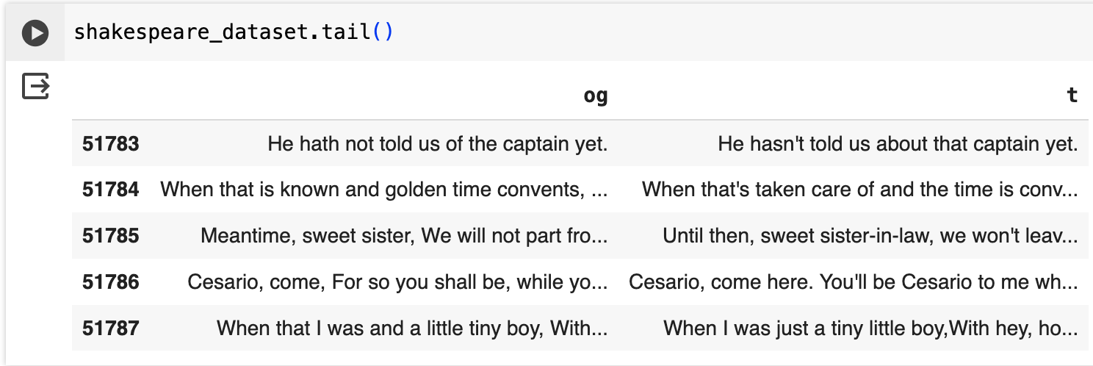
Preprocessing
Special characters and diacritics were removed from the text.
Data preparation with operations such as lowercase conversion, punctuation handling, and tokenization was done. Input sentences were cleaned and standardized before further processing.
Keras Preprocessing Tokenization was used to convert sentences into sequences of integers, allowing the model to work with numerical data.
Notes:
Nidhi

Slide 5
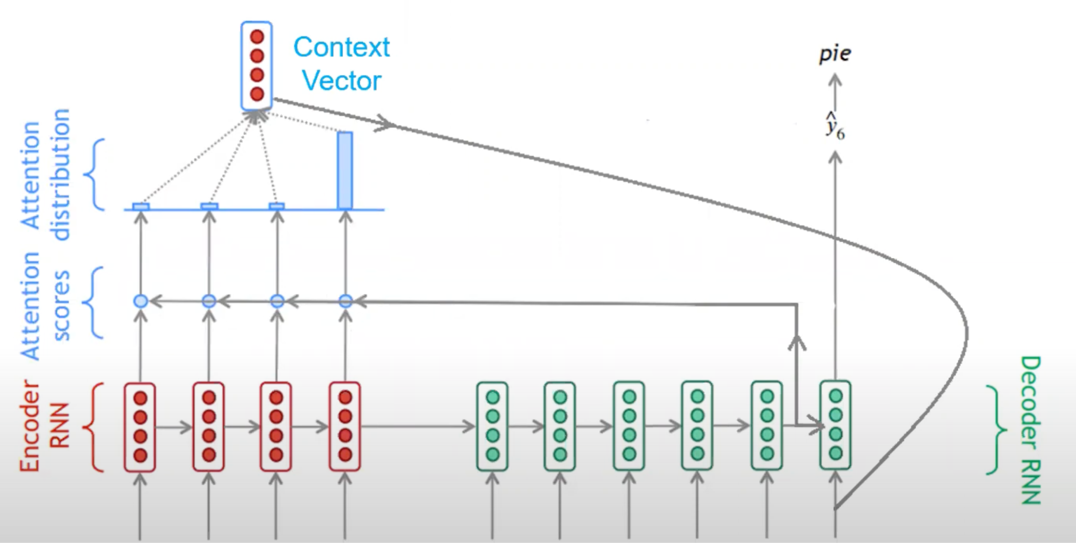
Model Architecture
The model follows the encoder-decoder architecture using GRU, a popular framework for sequence-to-sequence learning.
Two attention mechanisms are implemented: Dot Product Attention and Bahdanau Attention.
The loss function used is Sparse Categorical Cross entropy, which measures the difference between the predicted and actual probability distributions over the target vocabulary.
Adam optimizer is used to minimize the loss during training.
L2 regularization is applied to the embedding layers and the fully connected layers of the encoder and decoder to prevent overfitting
The training loop iterates over the dataset for a 10 epochs.
Notes:
Nidhi

Slide 6
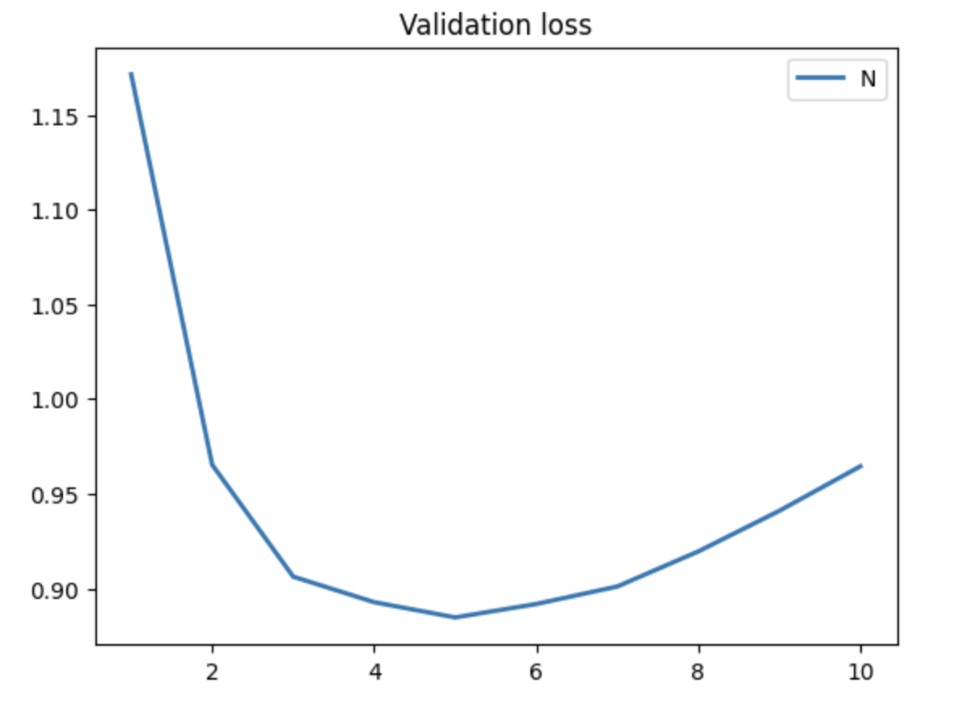
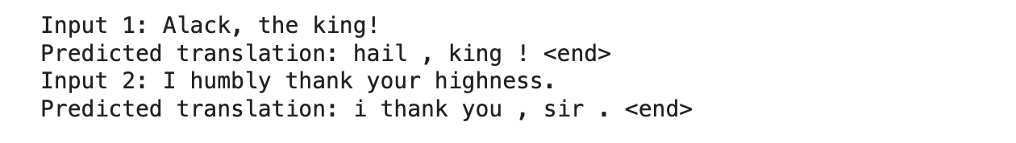
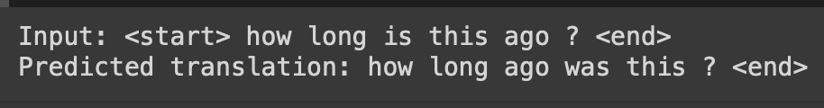
Results
The output demonstrates the training progress of a sequence-to-sequence model over 10 epochs, showcasing decreasing loss values for both training and validation sets, indicating effective learning and generalization.
Notes:
Snigdha

Slide 7
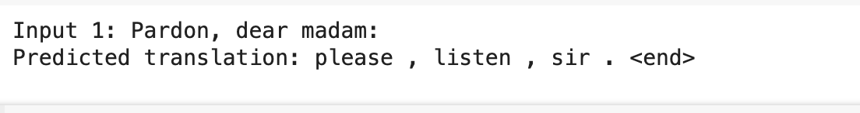
Conclusion
It is also observed that :
Expected : Excuse me, dear madam.
The quality and quantity of the training data directly impact the model's performance.
Limited computational resources could also restrict the model's training time or capacity, affecting its performance.
BLEU score relies solely on n-gram overlap between the predicted and reference translations and may not fully capture the quality of translations, especially in cases where paraphrasing or semantic similarity is involved.
We also did human evaluation and got an accuracy of 45 percent.
Notes:
Snigdha

Slide 8
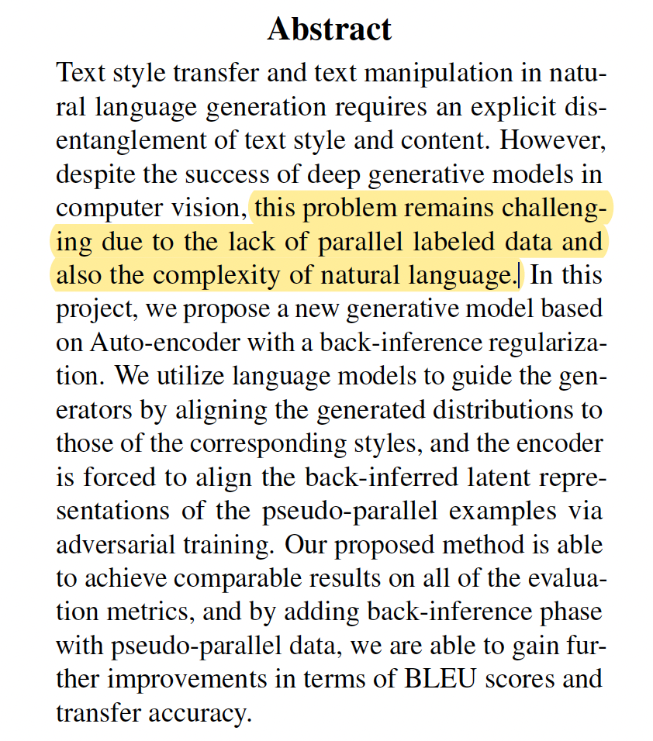

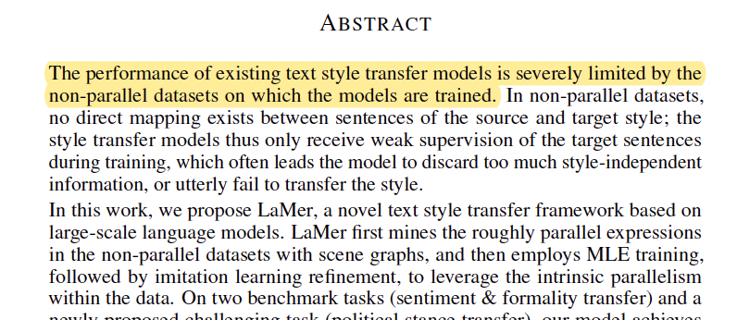
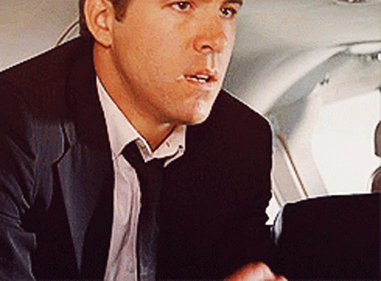
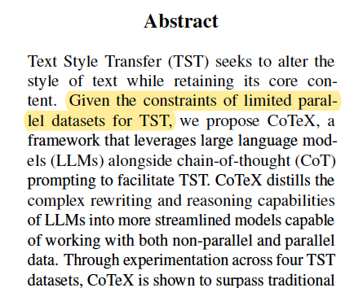
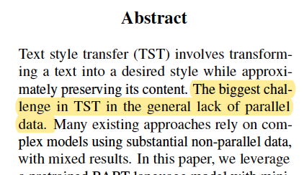
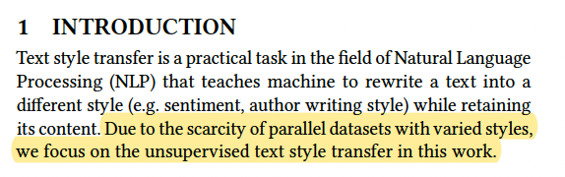


Why Unsupervised Learning?
Notes:
Snigdha

Slide 9
Objective
The objective of this project is to convert the positive reviews into corresponding negative reviews.We referred the methodology to address this problem using Unsupervised Text Style Transfer by referring the paper: IMaT: Unsupervised Text Attribute Transfer via Iterative Matching and Translation authored by Zhijing Jin, Di Jin, Jonas Mueller, Nicholas Matthews and Enrico Santus.
Notes:
Snigdha

Slide 10
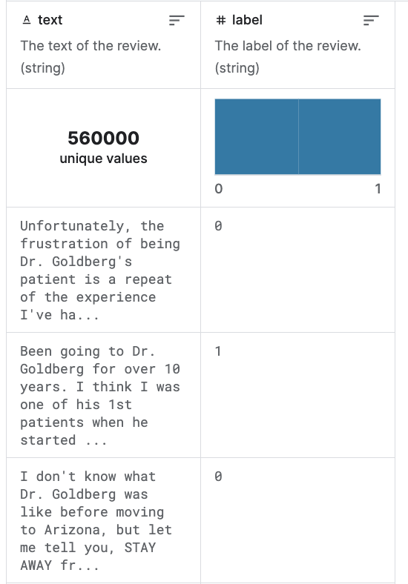
Dataset
The Yelp Reviews Polarity dataset was used in the project and is extracted from The Yelp reviews dataset consists of reviews from Yelp about various Business Sources. Credits to Xiang Zhang for constructing the polarity dataset.
text is the text of the review. label represents the sentiment with 0 and 1 indicating negative and positive reviews respectively.
Notes:
Snigdha

Slide 11
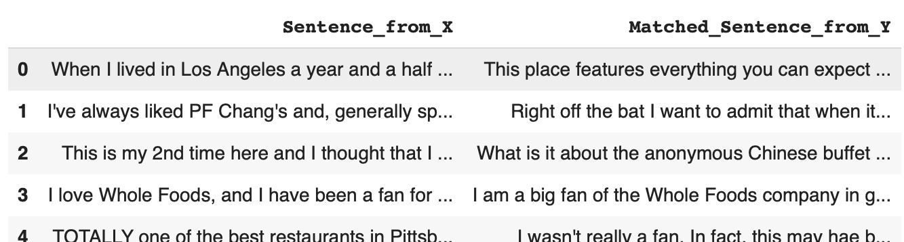
Preprocessing
The text had NAN characters and back slashes as well as other special characters that were removed.
The text was lowercase and standardized allowing us to effectively utilize the GloVe model for computing the Word Mover's Distance between sentences, offering a measure of semantic shift crucial for our iterative refinement process.
Notes:
Snigdha

Slide 12
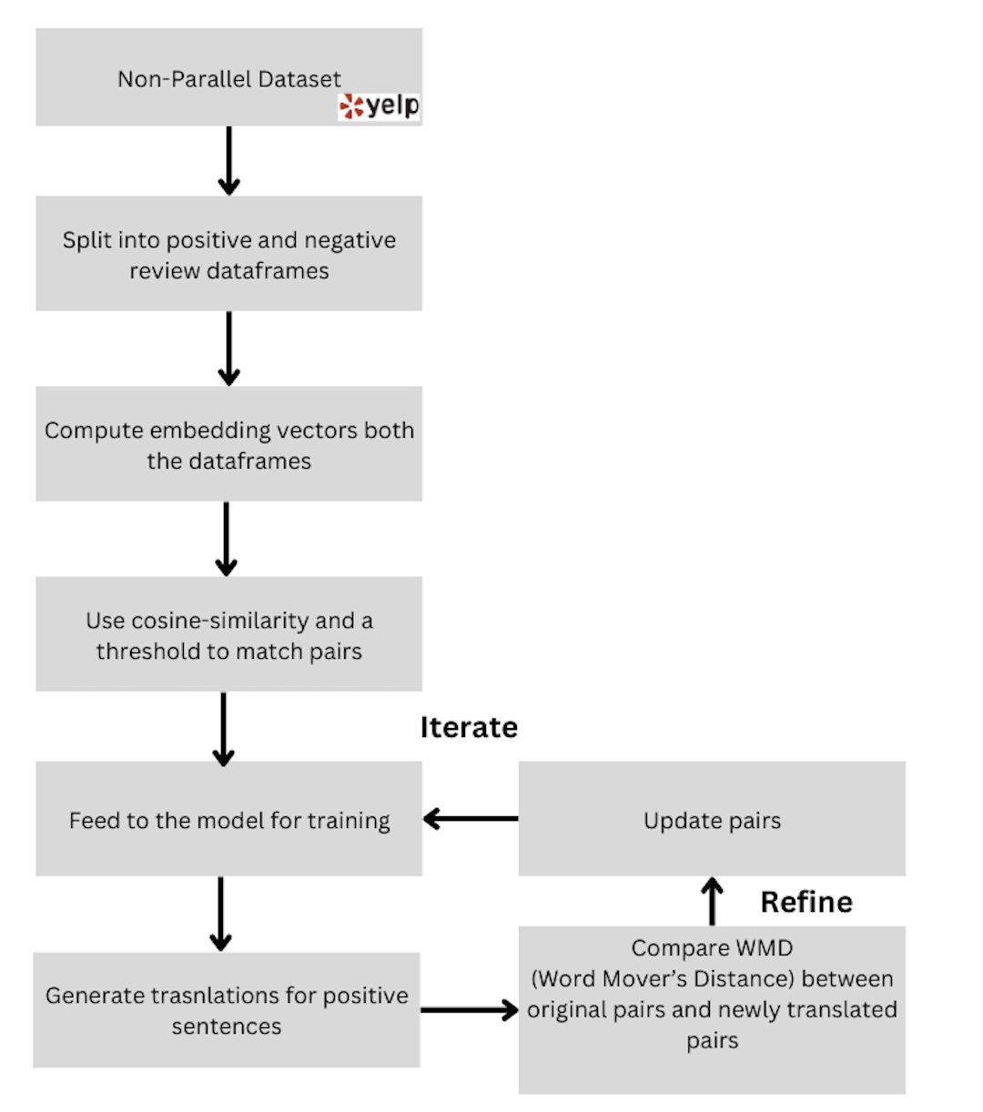
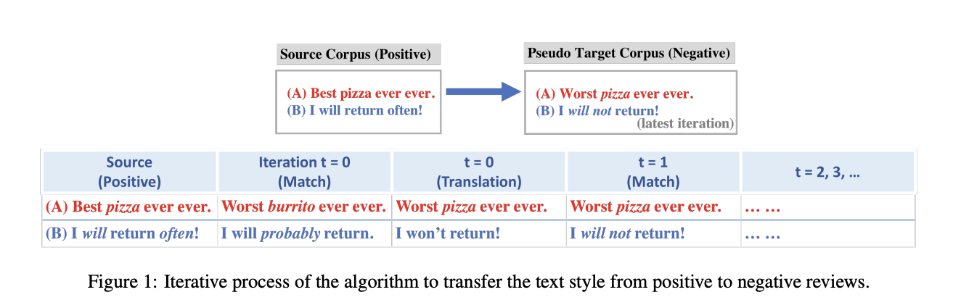
Iteratively Refine and Train
Notes:
Ovesh

Slide 13
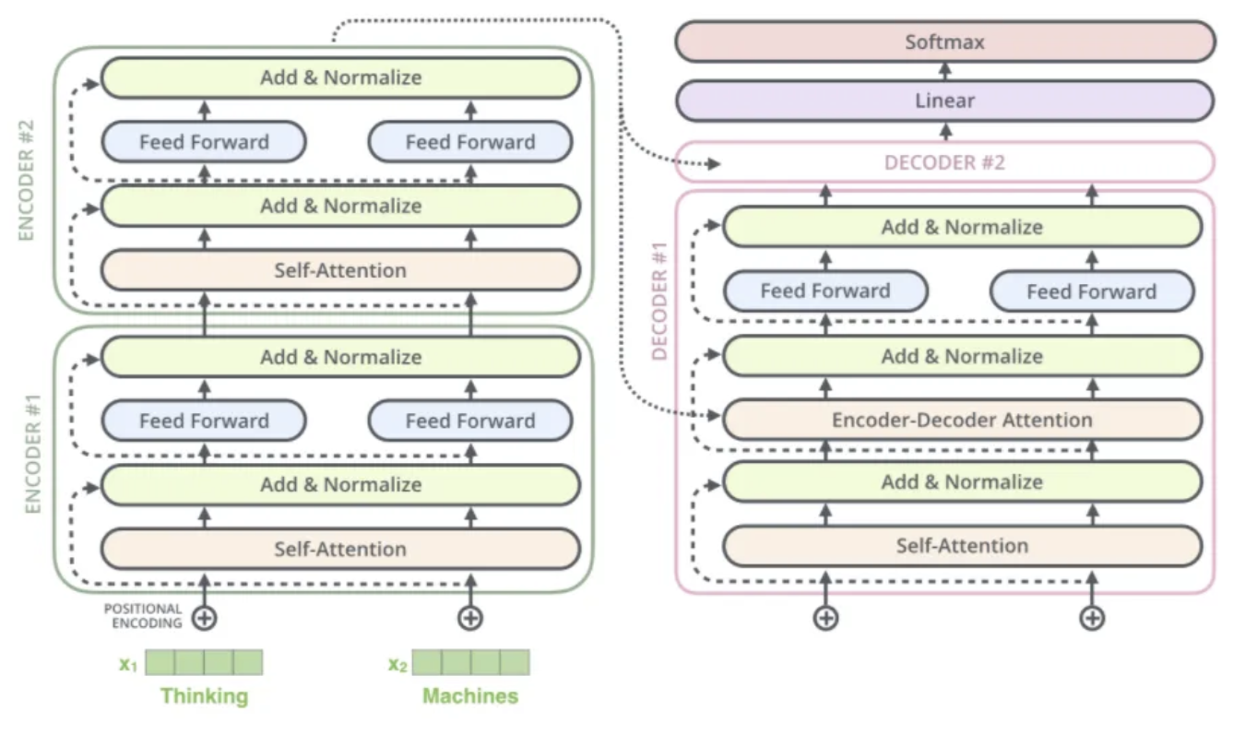
Model Training Approach
T5, or Text-to-Text Transfer Transformer, is a Transformer based architecture that uses a text-to-text approach.
We feed the model text as input and training it to generate some target text.
We have trained it for 30 epochs with Adam optimizer and having 100 warm up steps.
We have also employed early stopping condition so that if incase the evaluation loss increases we stop the training and choose the best model.
Notes:
Ovesh

Slide 14
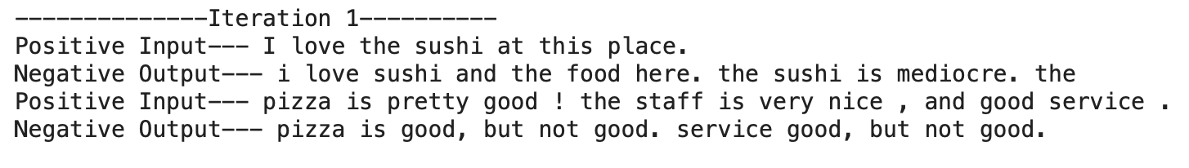
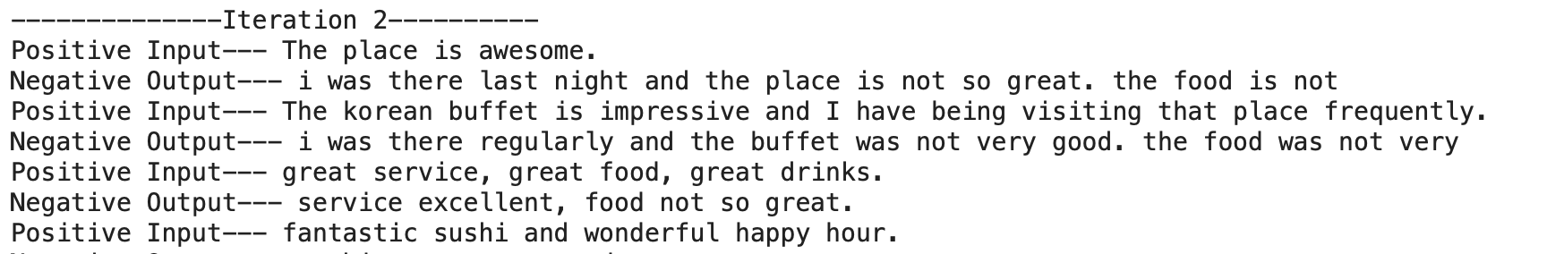
Results
After the first iteration when again updated the dataset we found that there were 154 rows updated with the new data pairs.
Notes:
Ovesh

Slide 15
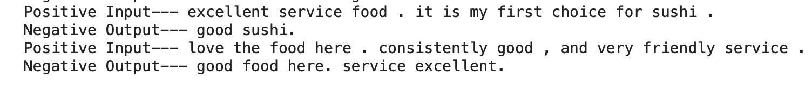
Future Scope
In somecase the model is not changing the nature of the sentence but giving the same output and hence if not monitored can be updated in the dataset pair.
To avoid this we should add a classification layer in between to classify weather the nature of sentence is positive or negative.
Notes:
Ovesh

Slide 16
Conclusion
The approach is highly beneficial when working with unsupervised data. But the approach demands some amount of data dependency in both types of dataset for making the initial pairing.
After each iteration the accuracy of the model increases which is was observed during human evaluation.
Since we were not training the model on a large dataset the Bleu score was low but showed incremental growth.
Using a independent transformer rather than a pre-trained transformer will be a better approach.
Notes:
Ovesh

Slide 17
Thank You!
Notes:
Ovesh

